Slide 1
Chapter 10
Challenges, Opportunities, and Future Prospects

Slide 2


Internet of things security
Security Standardization
Software or Code Integrity

Slide 3
Cloud Computing Based Security Solutions
DDoS attacks in cloud- backed IoT
DDoS and communication overhead
Interior cloud DDoS attack
Instantaneous cumulative analysis of traffic flows
Commercial loss
SDN-based cloud solutions
DDoS-for-Hire service

Slide 4
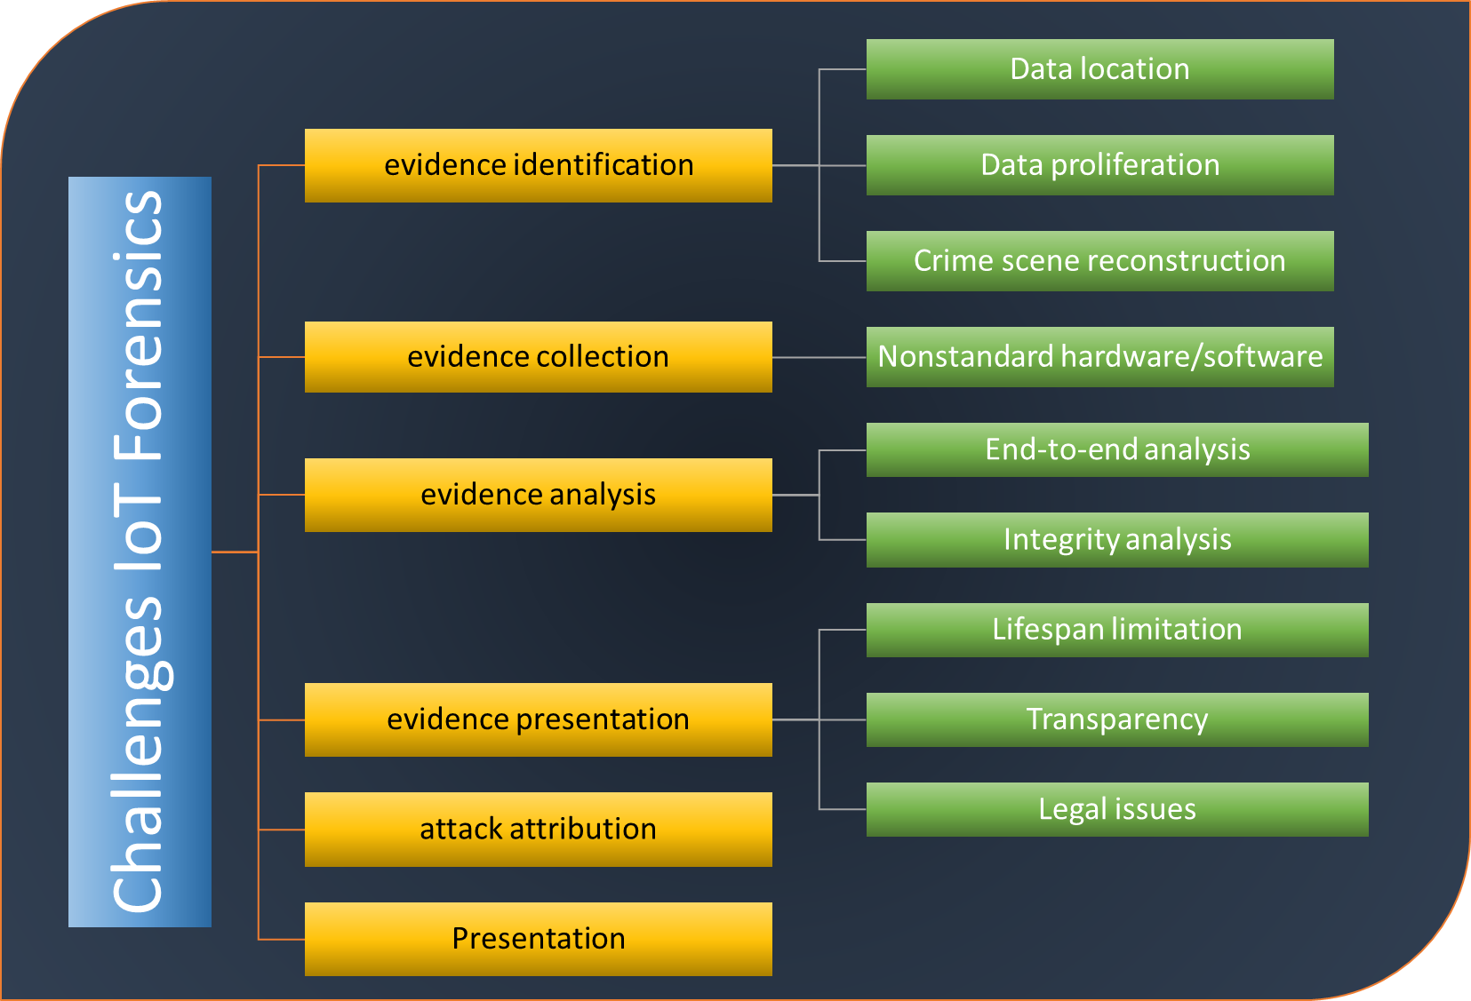
Cloud Computing Based Security Solutions

Slide 5
Fog Computing Based Security Solutions
Fog Intelligence
Security issues
Privacy issues
Maintenance issues
Interoperability issues

Slide 6
Edge Computing Based Security Solutions
Context-Informed Security
Microservices-based design
Mechanisms Orchestration and Standardization

Slide 7
Deep Learning for IoT Security
The dataset scarcity
IoT Security Solution based on low-quality data
IoT security data Augmentation
Zero-day attacks
Enduring Learning
Transfer learning
Interdependent, interrelated, and collaborative ecosystems

Slide 8
Deep Reinforcement Learning
Resistance against Adversarial reinforcement learning
Deficient Perception Dilemma
Joint reward from multiple agents

